Slide 1
Clustering Analysis-Based Identification of Key Indicators of Heart Disease Risk (K-Means Algorithm)
GROUP 1

Slide 2
Introduction
• Cardiovascular diseases (CVDs) are among the leading causes of mortality worldwide.
• Early identification of risk factors can aid in prevention and treatment.
• This study applies clustering and classification to analyze heart disease risks.

Slide 3
Dataset Description
• Dataset contains 1025 clinical records.
• Features: Age, Sex, Cholesterol, Chest Pain, Resting Blood Pressure, Thalach, etc.
• Target Variable: Presence or absence of heart disease.

Slide 4
Methodology
• Data Preprocessing: Handling missing values, normalization.
• Classification: Random Forest Classifier for heart disease prediction.
• Clustering: K-Means algorithm to categorize risk levels.
• Visualization and interpretation of cluster properties.

Slide 5
Findings & Visualizations
• K-Means clusters reveal distinct patient groups.
• Classification model achieves high predictive accuracy.
• Feature importance analysis provides insights into key risk factors.

Slide 6
Results and Analysis
• The clustering analysis divided patients into three distinct risk groups:
1. Cluster 0 (Low-Risk): Younger individuals with healthier cholesterol and heart function.
2. Cluster 1 (Moderate-Risk): Patients with mid-level cholesterol and some heart irregularities.
3. Cluster 2 (High-Risk): Older individuals with elevated blood pressure, increased cholesterol, higher oldpeak, and other risk indicators.
• The clustering results provide insights into early risk identification and intervention strategies.

Slide 7
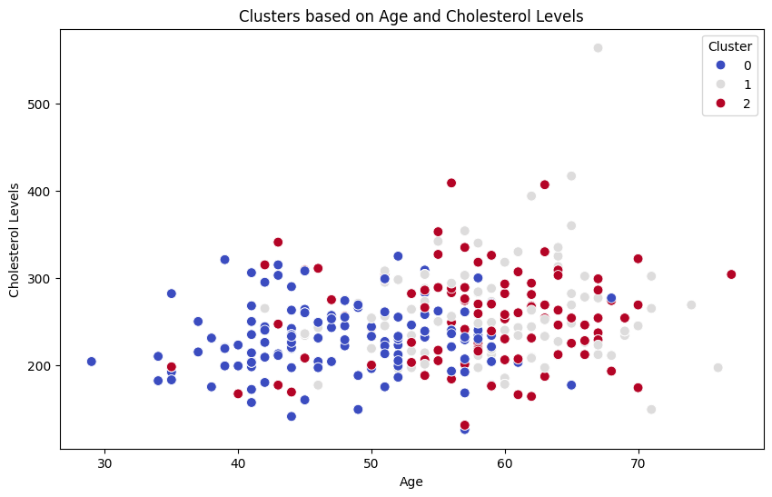
Figure 1: Cluster Scatter-plot based on Age and Cholesterol Levels
This visualization plots clusters based on
'Age' and 'Cholesterol Levels'.
Each cluster highlights how age and cholesterol levels
interact to define heart disease risk groups.
Observations:
Cluster 0 (Low-Risk): Individuals with lower
cholesterol and younger age.
Cluster 1 (Moderate-Risk): Patients with
mid-level cholesterol and moderate age.
Cluster 2 (High-Risk): Older individuals with high
cholesterol reinforcing cholesterol as a critical risk factor.
This analysis emphasizes the importance of cholesterol in determining heart disease risk.

Slide 8
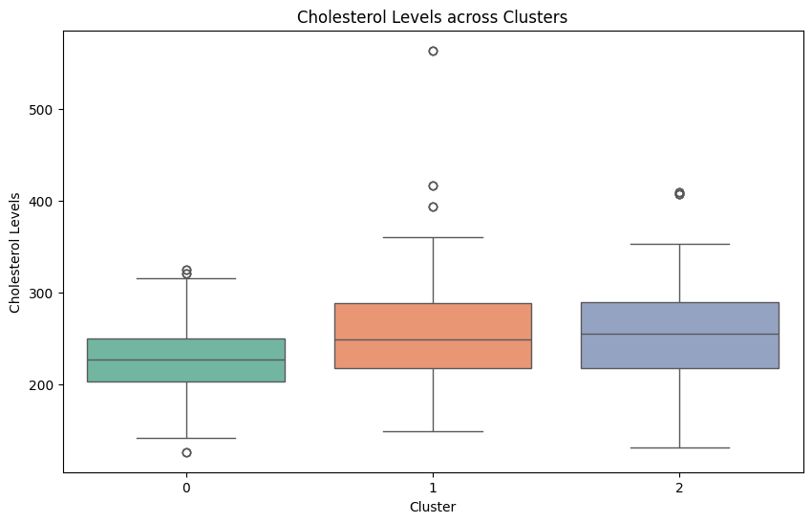
Figure 2: Box-plot of Cholesterol Levels across Clusters
This box-plot illustrates cholesterol level distributions across the clusters.
It highlights differences in average cholesterol
levels and variability within each risk group.
Observations:
Cluster 0 (Low-Risk): Lower cholesterol
levels with less variability.
Cluster 1 (Moderate-Risk): Mid-range
cholesterol values with moderate spread.
Cluster 2 (High-Risk): Elevated cholesterol levels with
higher variability, reinforcing its correlation
with heart disease risk.
The distribution of cholesterol within each cluster
offers deeper insights into risk stratification.

Slide 9
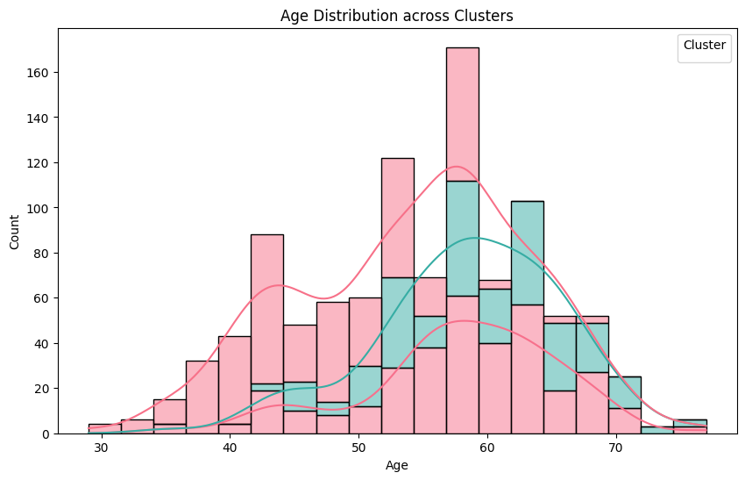
Figure 3: Age Distribution across Clusters
This histogram visualizes the age distribution within each cluster.
It highlights how different age groups align with heart disease risk
categories.
Observations:
Cluster 0 (Low-Risk): Predominantly younger individuals
, reinforcing a lower risk profile.
Cluster 1 (Moderate-Risk): A mix of middle-aged
individuals, representing moderate risk.
Cluster 2 (High-Risk): Composed mainly of older
individuals,suggesting age as a key risk factor.
These insights emphasize the role of age in defining
heart disease risk levels, paving the way for further analyses on
additional features

Slide 10
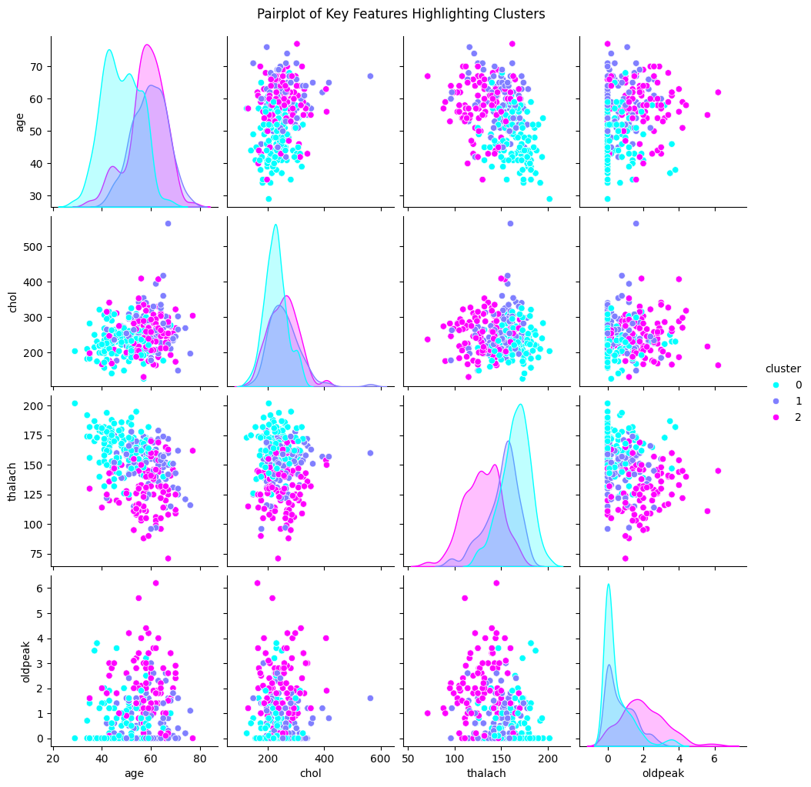
Figure 4: Pair-plot of Key Features Highlighting Clusters
This pair-plot visualizes relationships between key features
('age', 'chol', 'thalach', and 'oldpeak') across clusters.
It highlights how different risk groups vary in
feature combinations.
Observations:
Clusters show distinct patterns, such as low 'thalach'
(maximum heart rate) paired with
high 'oldpeak' in higher-risk groups.
High-risk clusters tend to have increased cholesterol
('chol') and reduced heart function ('thalach').
Moderate-risk clusters exhibit intermediate
feature distributions.
These feature correlations provide valuable insights for risk
assessment and potential targeted interventions.

Slide 11
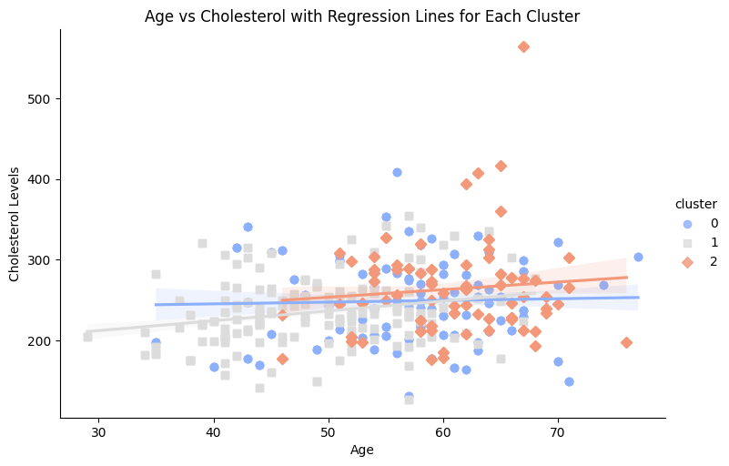
Figure 5: Regression Line for Age vs Cholesterol across Clusters
This scatter plot with regression lines compares age and cholesterol levels across clusters.
It illustrates trends within each risk group,
showing how cholesterol levels evolve with age.
Observations:
Cluster 0 (Low-Risk): Shows stable or slightly
increasing cholesterol levels with age.
Cluster 1 (Moderate-Risk): Displays a moderate upward
trend in cholesterol with aging.
Cluster 2 (High-Risk): Exhibits a steeper increase
in cholesterol levels, reinforcing age as a crucial
factor in heart disease risk.
Lines: Each cluster has a line (called a regression line) that
shows the general trend of how cholesterol changes with age
for that group. The shaded area around each line shows the range of uncertainty.
These patterns emphasize age-related cholesterol trends
and their influence on heart disease risk categorization

Slide 12
IV. Discussion
The clustering and visualization techniques highlight significant patterns correlating age, cholesterol, oldpeak, and thalach with heart disease risk.
These insights can aid in early diagnosis and targeted interventions, reducing the burden of cardiovascular diseases.
Future Work:
Incorporate larger and more diverse datasets to enhance model generalizability.
Explore additional machine learning techniques for improved clustering and classification accuracy

Slide 13
V. Conclusion
This study demonstrated the effectiveness of K-Means clustering and Random Forest classification for heart disease risk analysis.
The identified clusters offer actionable insights for clinical risk stratification.
Findings emphasize the importance of data-driven methodologies in cardiovascular research for better preventive strategies and medical interventions.

Slide 14
References
World Health Organization, Cardiovascular Diseases (CVDs).
K. He et al., Delving Deep into Clustering Techniques, Machine Learning Journal, vol. 45, 2020

